Slide 1

Department of Information Technology
A.P. Shah Institute of Technology
G.B.Road,Kasarvadavli, Thane(W), Mumbai-400615
UNIVERSITY OF MUMBAI
Academic Year 2020-2021

Slide 2
A Project Report on
Question Paper Generation at a Click Supporting Outcome Based Learning
Submitted in partial fulfillment of the degree of
Bachelor of Engineering(Sem-8)
in
INFORMATION TECHNOLOGY
By
AnmolSingh Paman- 18204003
Rahul Rahi-17104057
Abhishek Jha-18204008
Under the Guidance of
Prof. Yaminee Patil

Slide 3
1.Project Conception and Initiation

Slide 4
1.1 Abstract
Assessment process is an essential activity in educational institutions to test performance of the learners. The essence of examination papers is directly linked to evaluation of quality of the graduates passing out.
Nevertheless, designing question papers is laborious/tedious task for the teachers. This system is aimed to replace manual method practiced by academics.
This system intends to enable academics to produce quality examination papers on the click, that are unbiased, streamlined, randomized and secure while saving the time and resources in the assessment process.
We have 2 types of user- Admin, Faculty.
Admin: to Add, Modify, Delete users and store their information in database
Faculty: to Add Questions and save them in Question bank database; Generate question paper and Export the generated Question Paper. System returns generated paper and exports it into user’s computer.

Slide 5
1.2 Objectives
Question entered in the database should cover the Syllabus.
Question Paper formed should address the desired Course Objectives
Question Paper formed should be confirmed by the NBA co-ordinator.

Slide 6
1.3 Literature Review
Paper Title : Automatic Generation of Question Paper from User Entry Specifications using a Semantically Tagged Question Repository
Authors: Gauri Nalawade, Rekha Ramesh
Publication details : 2016 IEEE Eighth International Conference on Technology for Education (T4E). doi:10.1109/t4e.2016.038
Findings:
The proposed system automatically generates the question paper from this semantically tagged question repository. Since
The existing systems are rigid and lack the flexibility of supporting all types of tags and also have Security Issues.
The system supports all four tags and also flexible enough to provide an interface that allows user to enter specifications for each tag/property in the form of lower and upper bounds.
Each property is specified with a range indicating that value should not be lower than minimum value and not exceed the maximum value of the range.
It is rule base system which takes all the combinations of the tags and generates output based on the rule applicable. The output is generated in xml format and in word document.

Slide 7
1.3 Literature Review
Paper Title : Choosing the right LMS: A performance evaluation of three open-source LMS
Authors: A. C. Caminero, R. Hernandez, S. Ros,A. Robles-G ́omez, Ll. Tobarra
Publication details :Caminero, A.C. ; Dept. de Sist. de Comun. y Control, Univ. Nac. De Educ. a Distancia, Madrid, Spain ; Hernandez, R. ; Ros, S. ; Robles-Gomez, A. , “Choosing the right LMS: A performance evaluation of three open-source LMS”, Global Engineering Education Conference (EDUCON), 2013 IEEE, March 2013
Findings :
The existing Learning Management Systems (LMS) support very basic level or limited tags such as question types.
Even the most preferred LMS, Moodle allows creating only subjective/objective type of questions.
Thus automatically generating question paper from a teacher’s entered specification using a semantically tagged QR is the need of the hour today.
The comparative study shows that Moodle is best LMS to support large number of users and also for any educational institution.

Slide 8
1.3 Literature Review
Paper Title :BLOOM’S TAXONOMY-BASED EXAMINATION QUESTION PAPER GENERATION SYSTEM.
Authors: Yulia Timakova FTMS College, Kinn Abass Bakon FTMS College
Publication details: International Journal of Information System and Engineeringwww.ftms.edu.my/journals/index.php/journals/ijiseVol.6 (No.2), November, 2018ISSN: 2289-7615DOI: 10.24924/ijise/2018.11/v6.iss2/76.92
Findings :
This study involved overview of the assessment process and Bloom’s Taxonomy
Discussed advantages of information systems in assessment and several assessment generation systems were evaluated.
Survey was conducted to collect data from teachers to determine the issues and develop more efficient alternative.
Automated system prototype was developed as a basic desktop application in Visual Studio environment with functions such as secure login, question bank and generation algorithm to serve the main purpose of speedy design of question papers aligned with learning outcomes based on Bloom’s Taxonomy hierarchy.

Slide 9
1.4 Problem Definition
The existing system for Question Paper Generation requires human staff to chalk out questions that appear in the question paper. Question Paper creation is a tedious and time consuming task
To create a system which reduces Human Working process and also The Instructor to generate and Save The Question Paper Automatically.

Slide 10
1.5 Scope
Significantly reduces human involvement by processes automation
Helps retain resources by performing tireless rigorous work of information processing, hence instructors can focus more on academic part rather than devote much time to question papers design.
System allows for rapid data retrieval and manipulations to generate output on the click with minimum effort.
Robust algorithm provides unbiased results due to random selection of questions and eliminates duplications.
System offers concise storage of question items, question bank can cover wide range of subjects and question types
Have a good user interface
Be easy to operate
Be easy to understand by the user and operator
Be expandable

Slide 11
1.6 Technology stack
HARDWARE
Processor type: Minimum:- Intel Pentium 3/ Pentium 4
Recommended:- Intel Core 2 duo or higher
Processor Speed:- 2.1Ghz or more
RAM:- Minimum:- 2GB DDR3 RAM
Recommended:- 4GB DDR3 RAM
Hard Disk Space:- 160GB Hard Disk space

Slide 12
1.6 Technology stack
SOFTWARE
Operating System: Windows XP/2000/Vista/7/8/10 or Linux or MacOS
Languages used: PHP, JavaScript, HTML, CSS, XML
Algorithm Used- Shuffling Algorithm
Database:- MySQL Database
Browser:- Testing Environment
WAMP or XAMPP Server

Slide 13
2. Project Design

Slide 14
2.1 Proposed System
Working of the Proposed System:
User can register itself on the system on the registration page, wherein the user has to enter name, Email id and Password
Before user is able to access system, it is necessary to pass the authentication step through login form where user must enter the correct username and password given by system administrator. If user has administrator role, login form will redirect to Admin Portal. If login details match a Faculty role, user will be redirected to Faculty Portal.
The user can login to the portal using the login form where the authorized user is allowed to login. the user needs to enter username and the password. The user can be of 2 types. Here its either the faculty or the admin.

Slide 15
2.1 Proposed System
Working of the Proposed System:
If the user is admin then the privileges are :-
1) Faculty details : In this admin has the power to approve or disapprove faculty or even delete faculty on clicking the respective button.
2) Branch details: In this the new branches can be added using the branch name and click on the add branch button.it can be checked with the list given below. It can also be deleted later if no longer required.
3) Add subject: In this new subject can be added by entering new subject name, choosing the respective branch and finally click on the add subject button.
4) View subject: view the list of subjects available. Admin can also search using subject name. Or delete it.
5) Assign subject: click on the dropdown menu, select the faculty from the list and click search. a box appears where the subject must be chosen and click on assign button.
6) Assigned subject details: it displays subject name, also it has the faculty record button which shows the list of faculty assigned to particular subject. Delete button is used to remove the faculty assigned to particular subject.
7) Generate Question Paper: Here the Admin needs to simply select the subject, the marks and choose the level and the number of questions in the Question paper and click on Generate Question Paper Button.

Slide 16
2.1 Proposed System
Working of the Proposed System:
If the user is faculty then the privileges are:-
1) Add Questions: User can add question for a particular subject which is assigned by the admin to the user.
2) Display question: In this section user will see the questions entered by all the faculties and the user can also edit questions which are entered by him only.
3) Generate Question Paper: Here the Faculty needs to simply select the subject, the marks and choose the level and the number of questions in the Question paper and click on Generate Question Paper Button.

Slide 17
2.1 Proposed System
Working of the Proposed System:
The system retrieves questions from question bank using randomization and shuffling algorithm..
This process is performed until the specified set of questions is retrieved. Upon receiving the specified set of Questions, the Faculty can select the required questions from retrieved set of Questions to form the Question Paper.
After this the System checks the redundancy of the question’s i.e. whether or not it is repeated question or not.

Slide 18
2.1 Proposed System
Shuffling Algorithm:
Create an Array of N Location
Generate Random Number
If (loc==0)
Store Generated Number
Else
Compare Generated Number with Previous Number in Array
If matching value found, gotoStep 2
Else
Store the number in Next Location
Repeat Step 2 for N numbers
Select Question from DB matching with values from array location one by one.

Slide 19
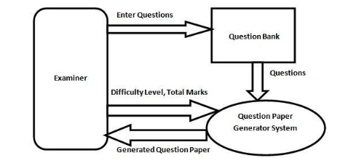
2.2 Design(Flow Of Modules)

Slide 20
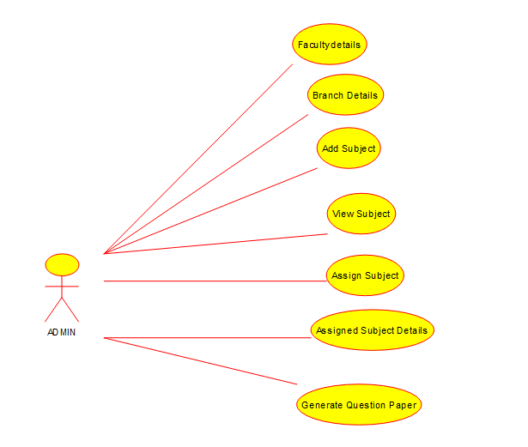
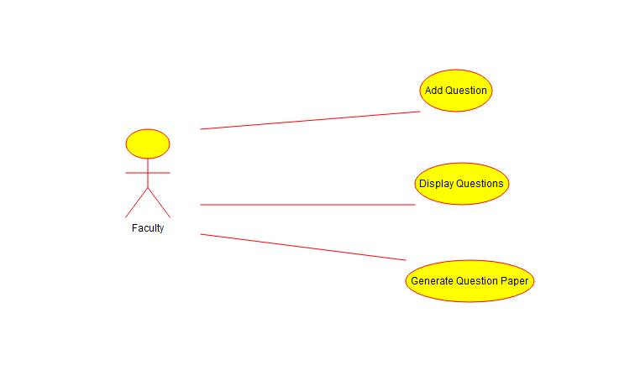
2.3 Description Of Use Case
Admin
Faculty

Slide 21
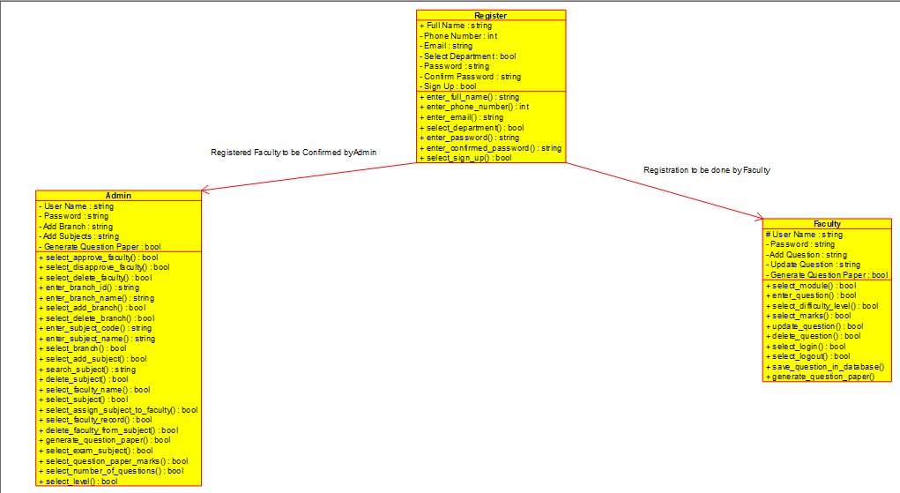
2.4 Class Diagram

Slide 22

2.5 Module-1
Index Page

Slide 23
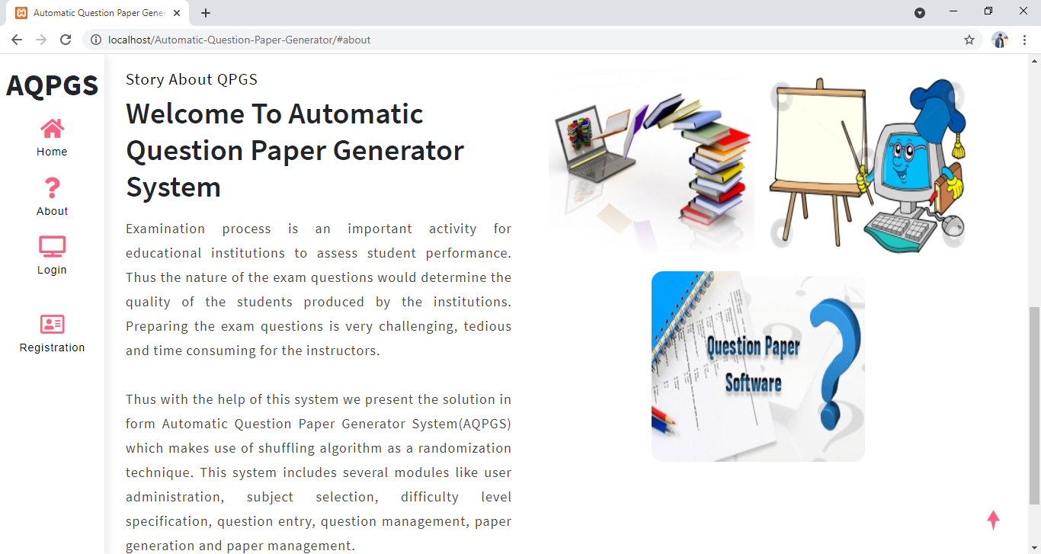
2.5 Module-1
About Page

Slide 24
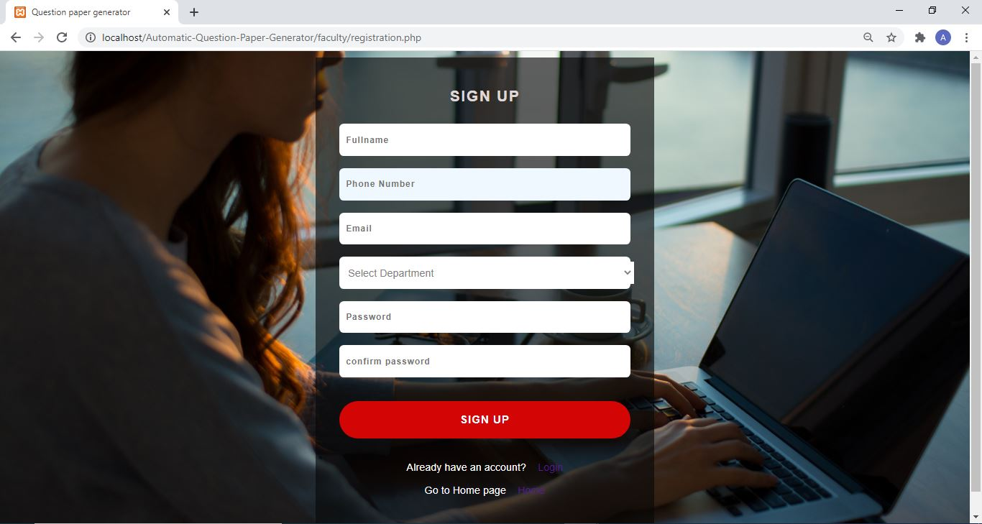
2.5 Module-1
Registration Page

Slide 25
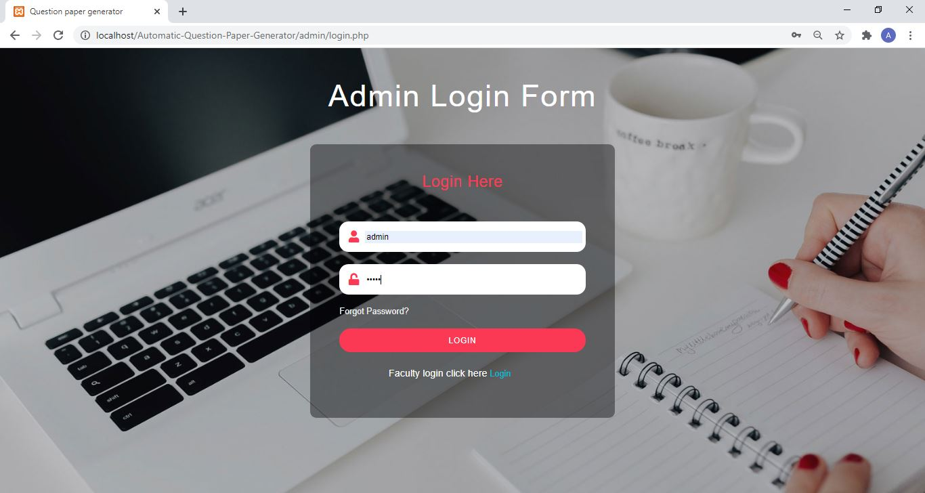
Module-2 : Admin
Admin Login Page

Slide 26
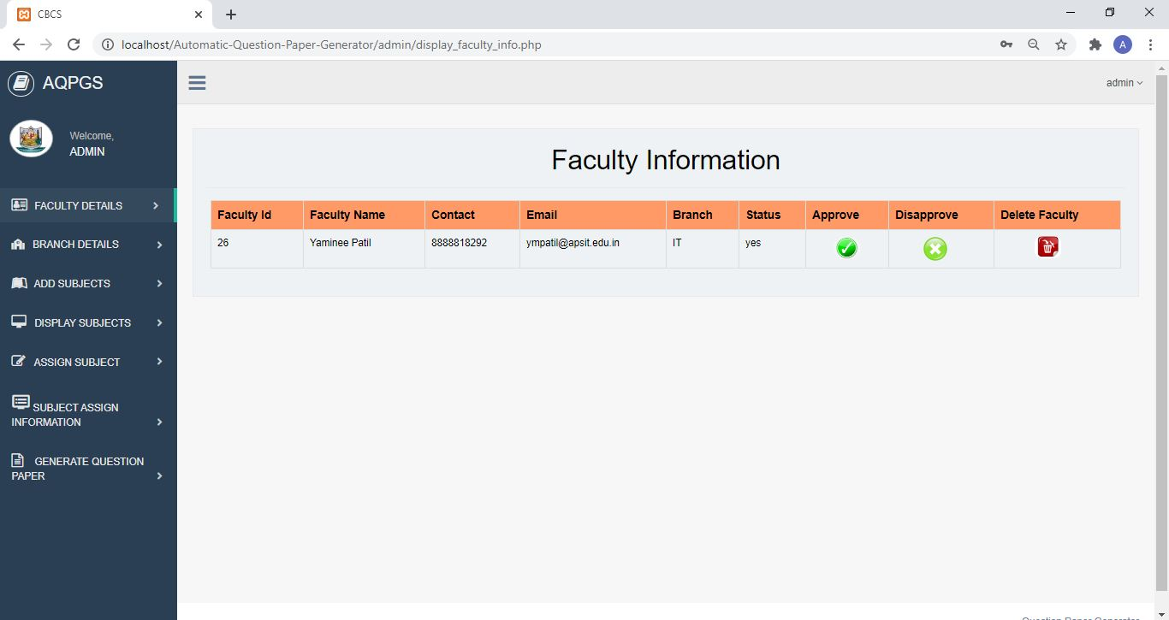
Module-2 : Admin
Faculty Details Page

Slide 27
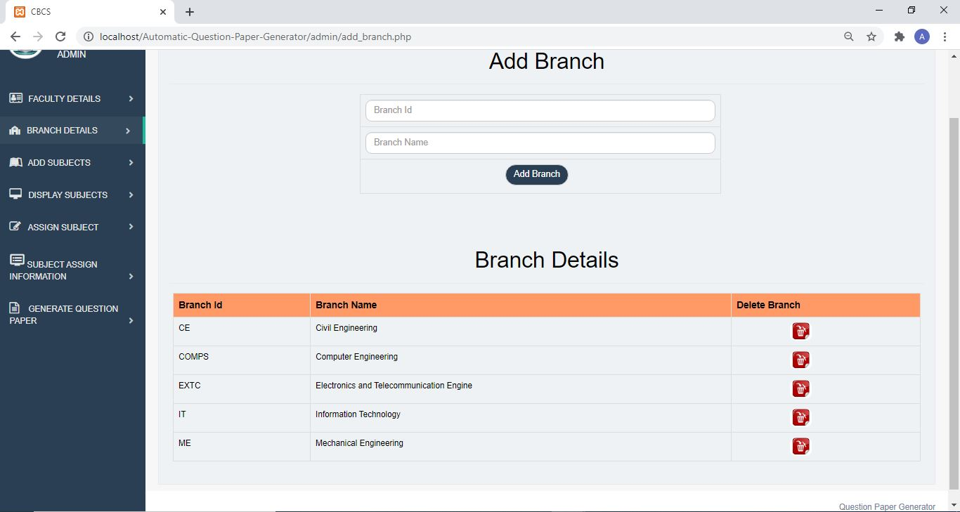
Module-2 : Admin
Branch Details Page

Slide 28
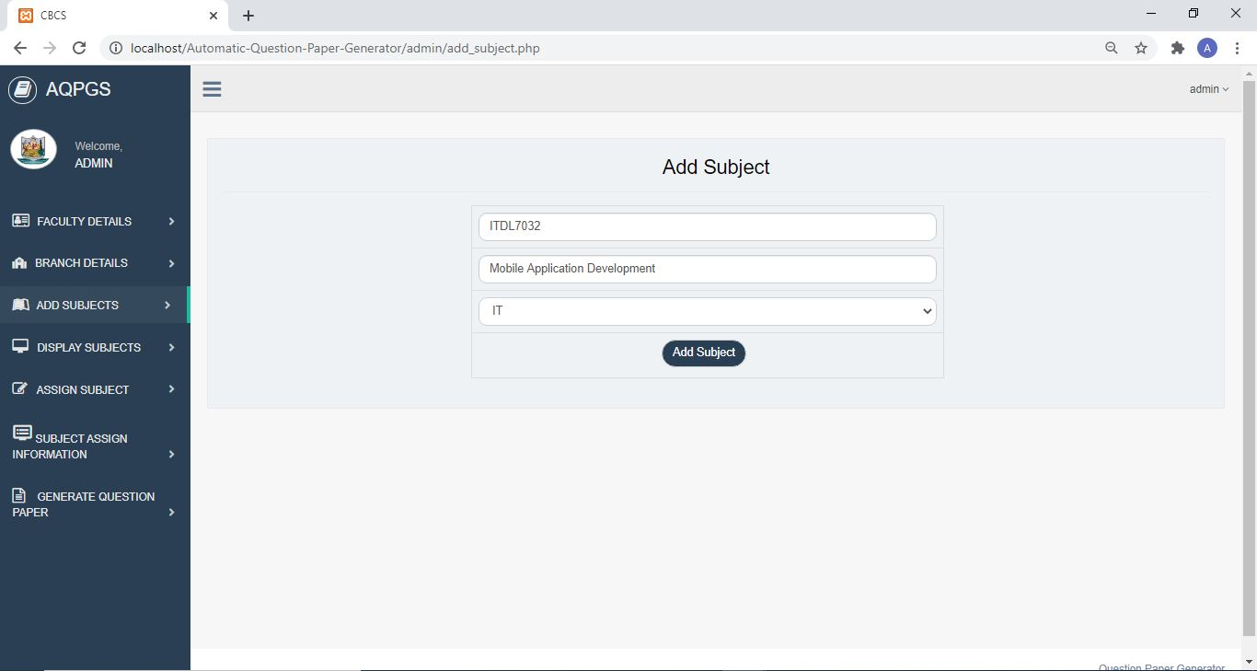
Module-2 : Admin
Add Subject Page

Slide 29
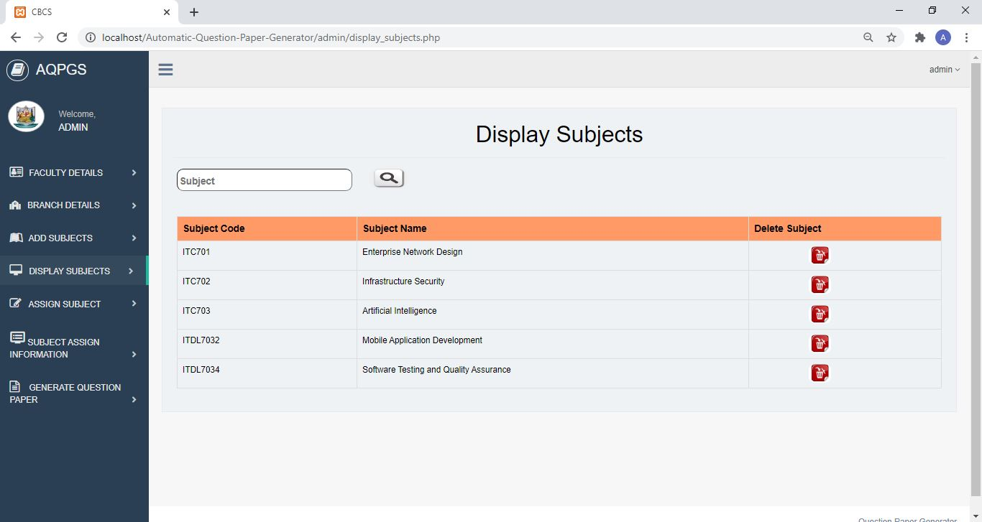
Module-2 : Admin
Display Subjects Page

Slide 30
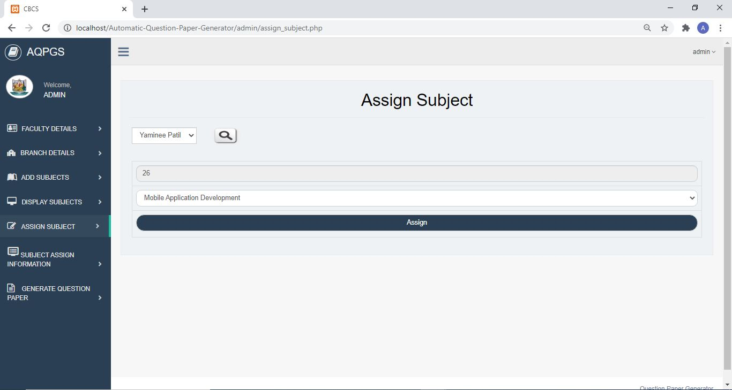
Module-2 : Admin
Assign Subjects Page

Slide 31
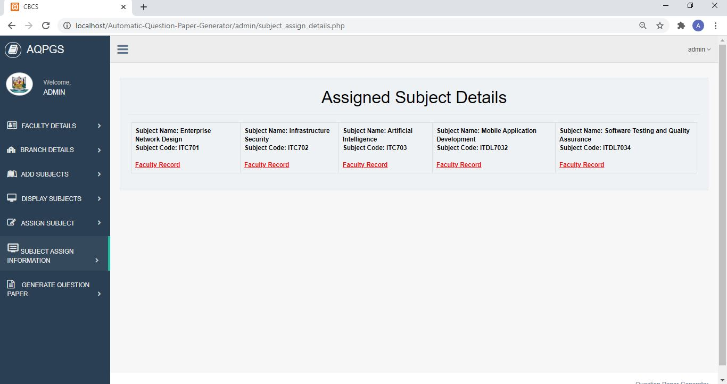
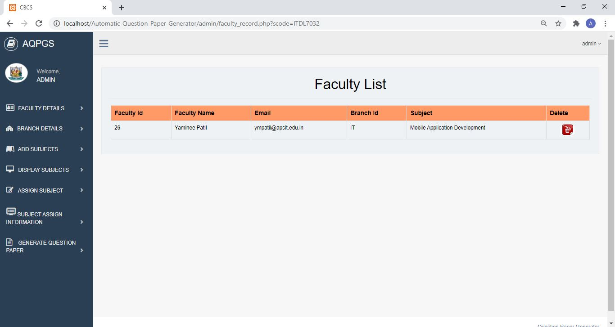
Module-2 : Admin
Subject Assigned Information Page

Slide 32
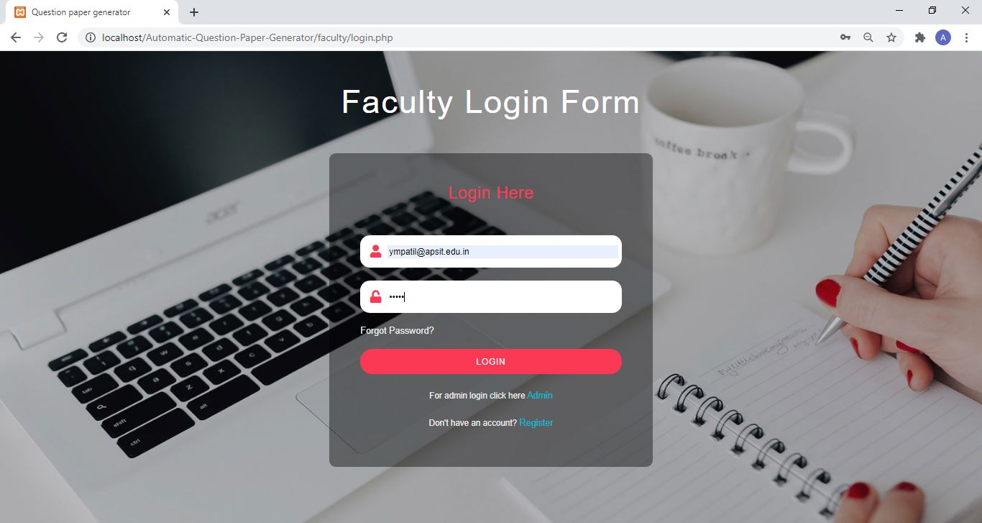
Module-3 : Faculty
Faculty Login Page

Slide 33
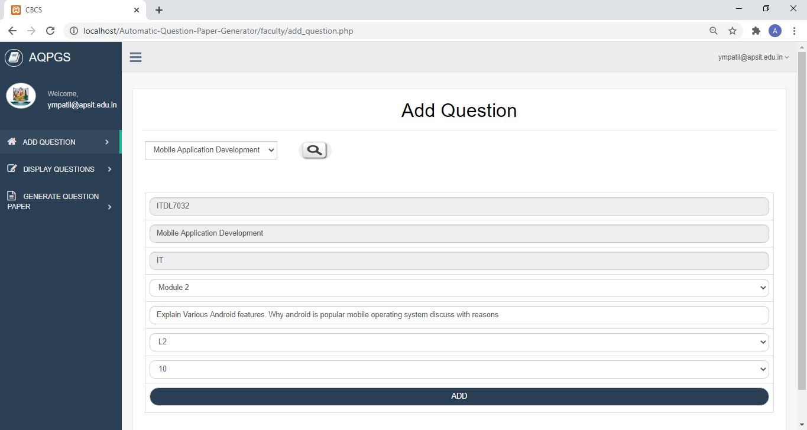
Module-3 : Faculty
Add Question Page

Slide 34
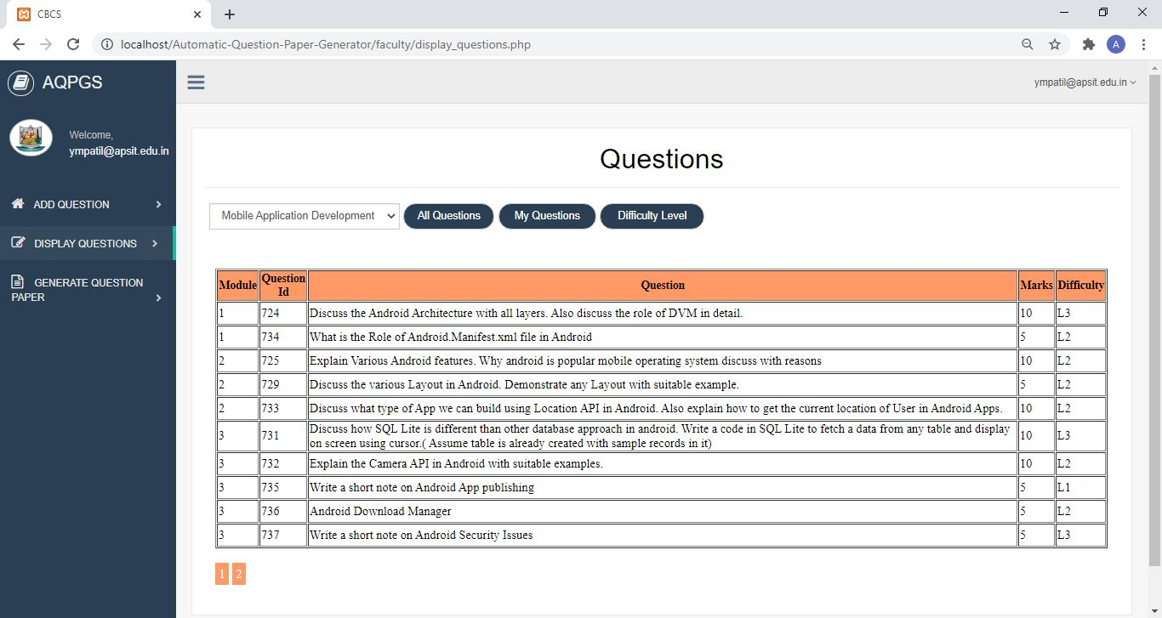
Module-3 : Faculty
Saved Question Page

Slide 35
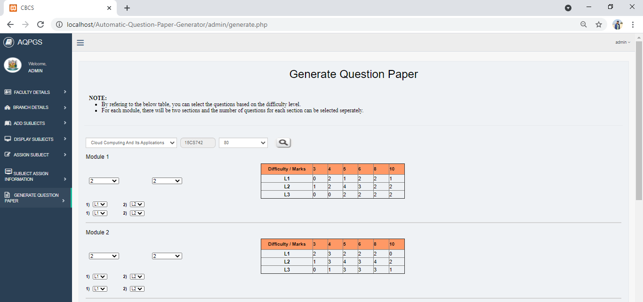
Module-4 : Generation of Question Paper

Slide 36
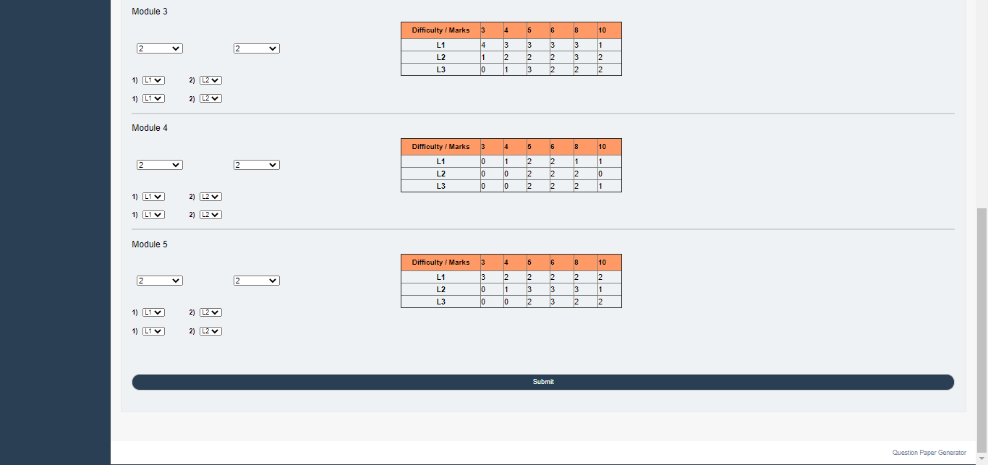
Module-4 : Generation of Question Paper

Slide 37
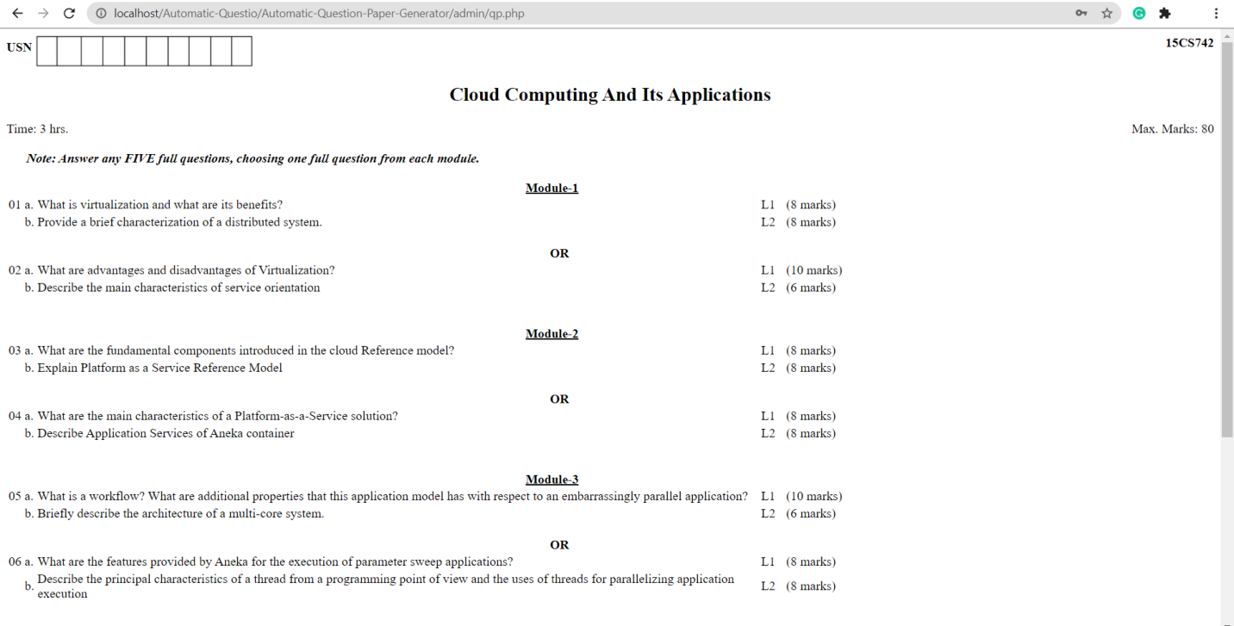
Module-4 : Generation of Question Paper
Generated Question Paper

Slide 38
3. Conclusion and Future Scope

Slide 39
3.1 Conclusion
Generate Question Paper automatically using Shuffling Algorithm for Randomization
Aim to reduce Human Effort
Helps to generate dissimilar paper with desired format.

Slide 40
3.1 Future Scope
Enhance the same software by making provision to produce question for online test in a Multiple Choice Question format.
Put in Machine Learning algorithms which will further help to identify if the generated Question Paper fulfils all the Course Objectives or not.

Slide 41
4. References
Automatic Generation of Question Paper from User Entry Specifications using a Semantically Tagged Question Repository
Choosing the right LMS: A performance evaluation of three open-source LMS
BLOOM’S TAXONOMY-BASED EXAMINATION QUESTION PAPER GENERATION SYSTEM by Yulia Timakova FTMS College Malaysiajuliati095@gmail.com, Kinn Abass Bakon FTMS College MalaysiaKinn@ftms.edu.my. International Journal of Information System and Engineeringwww.ftms.edu.my/journals/index.php/journals/ijiseVol. 6 (No.2), November, 2018ISSN: 2289-7615DOI: 10.24924/ijise/2018.11/v6.iss2/76.92

Slide 42
Thank You

